Slide 1


Amina Khaja, Kavya Parvathapuram, and Vinay Daram - Group 3
INFO 5082- Seminar in Research and Research Methodology

Slide 2

Leveraging Virtual Reality and AI for Healthcare: Personalized Diet Analytics and Mental Health Support During the COVID-19 Pandemic
This project explores the integration of AI, VR, and data analytics to tackle dietary and health challenges posed by COVID-19. It features a virtual reality AI assistant, a personalized diet plan generator, and analysis of global food supply data.

Slide 3
Agenda
Title
Motivation
Background
Abstract (Problem statement)
Literature Survey
Objectives of the Study
Data Set and Data Processing
Research Design(Blueprint/Workflow)
Data Analysis and Model Description
Data Visualization and Results
Conclusion
References

Slide 4

Motivation
The COVID-19 pandemic had a significant impact on global health, highlighting the importance of lifestyle and nutrition in both prevention and recovery. This project aims to provide personalized nutrition recommendations and support for individuals recovering from COVID-19 by utilizing virtual reality (VR) and artificial intelligence (AI), with a focus on global food supply indicators and their correlation with health outcomes.
(Physicians Committee for Responsible Medicine: The Truth About Cholesterol and Plant-based Diets, 2023)

Slide 5
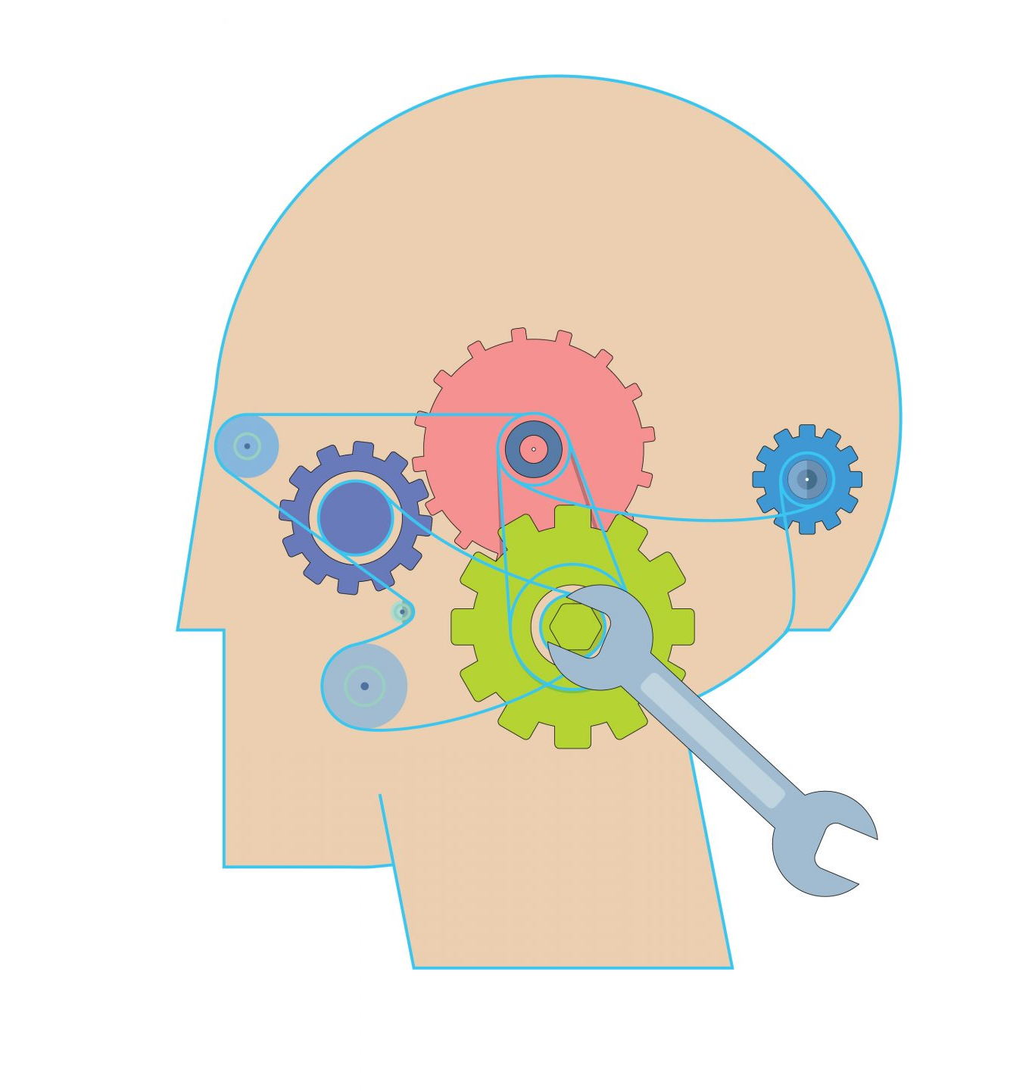
Background
The goal of this study is to enhance the present idea of creating a COVID-19 diet plan according to the patient's condition. This enhanced the COVID coach, which concentrates on the individual's mental health.
This helps giving meal suggestions.This makes meal suggestions easier. As the patient's health improves, the model adjusts the diet.
The adapting One of the tools used to manage the COVID diet plan dataset is hugging face transformers. The project was made as accurate and flawless as possible thanks to this understanding of the patient's state and the proper dietary reactions.
The current COVID coach app is focused on mental health, and we are working to create the perfect dietary plan to provide holistic care.
Nutrition played a critical role in helping healthcare systems around the world recover from the unprecedented challenges posed by COVID-19. Dietary habits have been shown to affect healing rates and immunological response in earlier studies. This initiative offers comprehensive support for training, mental health interventions, and rehabilitation by fusing data on nutrition and food supply with contemporary technologies like AI and VR.
(Fine-tuning Large Language Models: Complete Optimization Guide, n.d.)

Slide 6
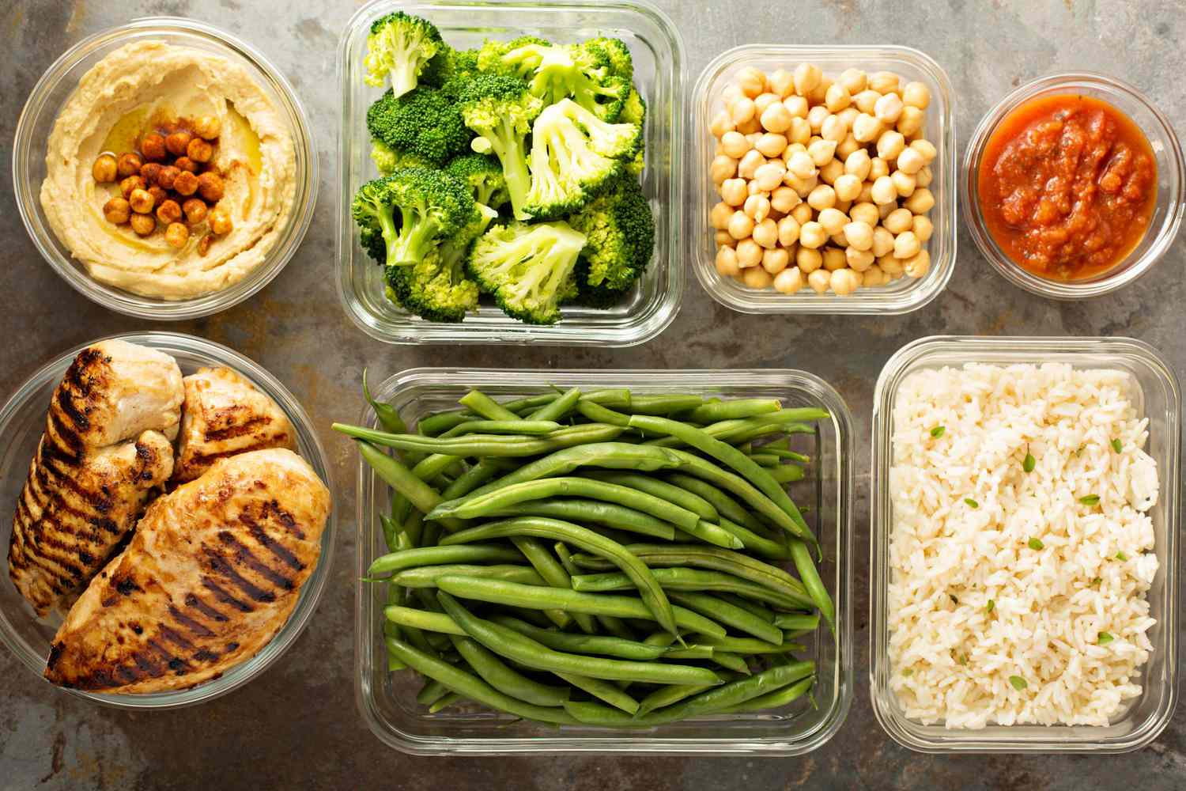
Abstract
This project investigates how to use AI, VR, and data analytics to address the dietary and health issues brought on by COVID-19. Its three main parts are a virtual reality AI assistant, a personalized diet plan generator, and an analysis of the COVID-19 Healthy Diet Dataset. In addition to creating diet plans and offering immersive educational and therapeutic virtual reality experiences, these tools offer insights about the world's food supply. The project integrates interactive virtual reality applications for healthcare support, AI-driven suggestions, and machine learning techniques for data processing and visualization.
(7 Day Diet Plan for Weight Loss, 2024)

Slide 7
Objectives Of the Study
Analyze the relationship between global food supply statistics and health outcomes during the COVID-19 epidemic.
Build a personalized diet plan generator using the user's food preferences and medical information.
Develop and implement an AI virtual reality assistant for therapy, patient support, and medical education.Explain the connection between obesity and food supply metrics.
(7 Day Diet Plan for Weight Loss, 2024)

Slide 8

Literature Survey
The COVID-19 pandemic has underscored the importance of personalized healthcare, The COVID-19 pandemic has brought attention to the importance of personalized healthcare, including dietary guidance. In addition to reviewing prior research on fine-tuning for medical applications, with a focus on dietary recommendations, this review of the literature highlights the challenges and opportunities in developing COVID-19 food programs.
Several studies emphasize the role of nutrition in strengthening immunity and improving recovery outcomes for COVID-19 patients. Research on VR in healthcare demonstrates its effectiveness in therapy, training, and patient education. AI-based personalized diet plans have gained traction for their ability to adapt to individual needs. This project synthesizes these approaches to create a comprehensive system that addresses nutritional, mental health, and educational challenges.
Accuracy, applicability, and ethical considerations should all be addressed when using LLMs in this context, and future studies should include methods for fine-tuning.
(Nutrition Week Day 4: One Week Healthy and Balanced Diet Plan, 2022)

Slide 9

Data Set and Data Processing
The selected dataset comes from Kaggle, which gathers data from nations all over the world. The data came from the Population Bureau, the Johns Hopkins Center for Systems Science and Engineering, choosemyplate.gov, and the Food and Agricultural Association of the United Nations (Ren, 2020). We may improve our model by combining the metrics to determine the relationship between diets and COVID-19 cases. COVID-19 Healthy Diet Dataset illustrates the connection between COVID-19 and dietary practices in many nations, including food availability, COVID-19 data, and obesity.
Fat_Supply_Quantity_Data.csv
Food_Supply_Quantity_kg_Data.csv
Food_Supply_kcal_Data.csv
Protein_Supply_Quantity_Data.csv
Supply_Food_Data_Descriptions.cs
(Icons, 2024)

Slide 10

Research Design
Data Collection:
Compile datasets on global food supply and nutrition metrics.
Preprocessing:
Handle missing values, normalize data, and prepare for analysis.
Data Analysis:
Explore correlations between food supply, obesity, and COVID-19 analysis.
Model Development:
Use AI models for personalized diet plan generation.
Fine-tune models for VR assistant functionality.
VR Integration:
Develop a VR assistant using Unity3D and AI for interactive healthcare support.
Deployment:
Create web-based dashboards and VR applications for user interaction.
After the model is complete, we will test it on actual patients and get input from their cases. The effects on the patient's physical and emotional health will then be tracked, and our model will be used to confirm the diet plan's efficacy. We'll see how the suggestions made by our model improve their quality of life. Since then, the model has been continuously updated in light of the patient's new information, discoveries, and comments. Additionally, we'll try to ensure that the model is adaptable enough to address criticism.
(Model Validation Icon Line Vector Illustration Pro Vector, n.d.)

Slide 11
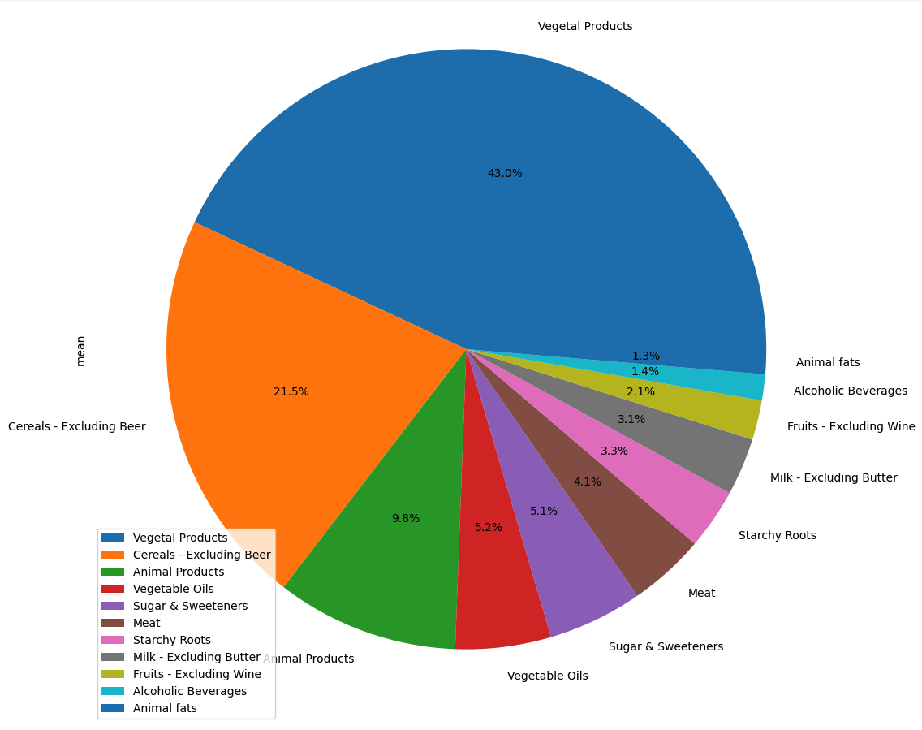
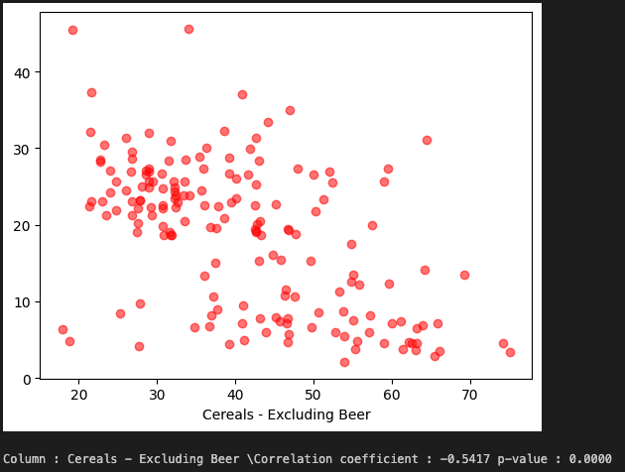
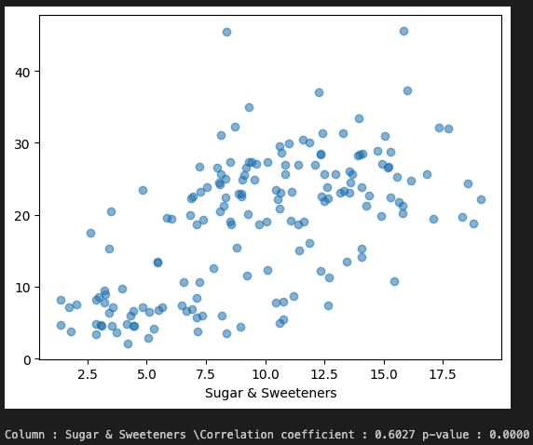
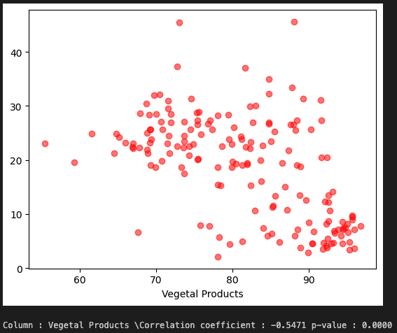
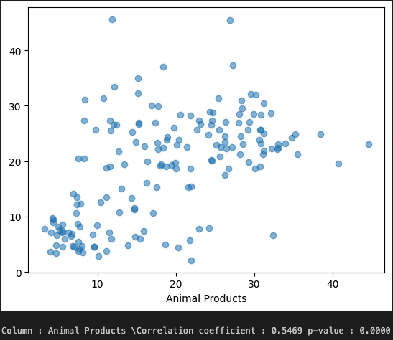
Data Analysis and Visualization Results

Slide 12
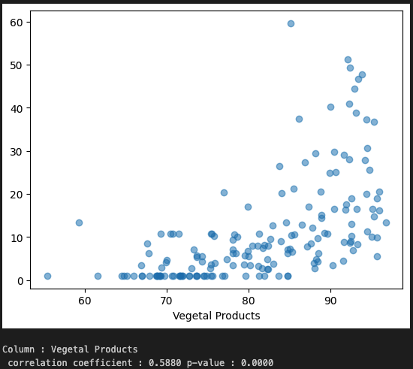
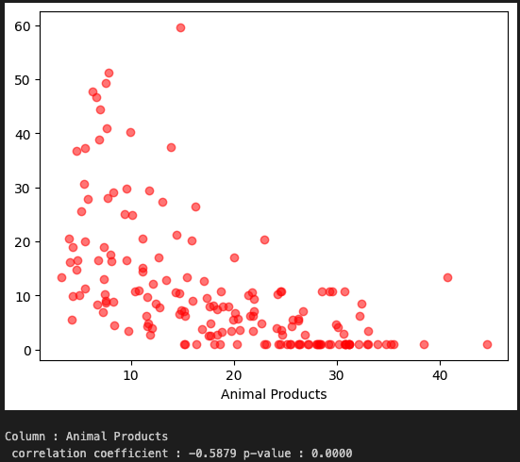
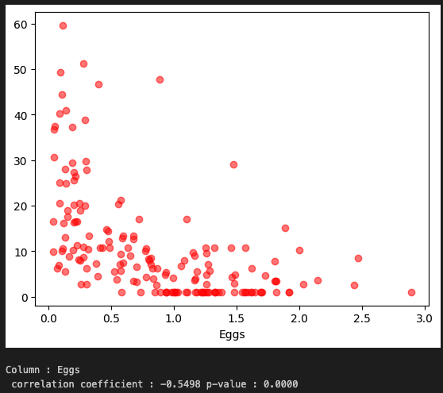
Data Analysis and Visualization Results

Slide 13
Future Study
Future research will focus on improving fine-tuning techniques to enhance AI-driven personalization, VR engagement, and applicability to broader datasets and health conditions.

Slide 14
Conclusion
Overall, Covid-19 had a significant impact globally around the world.In order to offer practical insights and healthcare solutions during the COVID-19 epidemic, the project effectively combines AI, VR, and data analytics. The diet plan generator and VR AI assistant addresses crucial topics including professional training, mental health, and nutrition. The virtual reality experience could be improved in future research, and its use could be extended to include additional medical issues.

Slide 15
References
Unity Technologies. (2021). Unity User Manual: Virtual reality development. Retrieved from https://docs.unity3d.com
Thomason, E., & De Vries, H. (2021). The impact of AI on personalized healthcare: A systematic review. Health Informatics Journal, 27(1), 11–22. https://doi.org/10.1177/1460458219886800
Deemer, A. D., Piper, B. F., & Armer, J. M. (2019). The role of virtual reality in healthcare education and training: A systematic review. Nurse Education Today, 79, 21–32. https://doi.org/10.1016/j.nedt.2019.04.018
Singh, A., & Choudhary, P. (2020). Data visualization techniques for COVID-19 analytics: A systematic approach. Data Science and Applications, 3(1), 44–58. https://doi.org/10.1016/j.dsap.2020.03.005
OpenAI. (2023). GPT models for conversational AI. Retrieved from https://platform.openai.com
Jaworski, B. K., Taylor, K., Ramsey, K. M., Heinz, A., Steinmetz, S., Pagano, I., Moraja, G., & Owen, J. E. (2021). Exploring usage of COVID Coach, a public mental health app designed for the COVID-19 pandemic: Evaluation of analytics data. Journal of Medical Internet Research, 23(3), e26748. https://doi.org/10.2196/26748
Ball, C., Huang, K. T., & Francis, J. (2021). Virtual reality adoption during the COVID-19 pandemic: A uses and gratifications perspective. Telematics and Informatics, 65, 101728. https://doi.org/10.1016/j.tele.2021.101728
Pallavicini, F., Pepe, A., Clerici, M., & Mantovani, F. (2022). Virtual reality applications in medicine during the COVID-19 pandemic: Systematic review. JMIR Serious Games, 10(4), e37918. https://doi.org/10.2196/37918

Slide 16
References for Images
7 Day Diet Plan for Weight Loss. (2024, July 7). Shape. https://www.shape.com/weight-loss/management/7-day-diet-plan-weight-loss
Fine-tuning Large Language Models: Complete Optimization Guide. (n.d.). scribbleData. https://www.scribbledata.io/blog/fine-tuning-large-language-models/
Icons. (2024). Flaticon. https://www.flaticon.com/free-icon/database_443829
Model Validation icon line vector illustration Pro Vector. (n.d.). Vecteezy. https://www.vecteezy.com/vector-art/37328713-model-validation-icon-line-vector-illustration
Nutrition Week Day 4: One Week Healthy and Balanced Diet Plan. (2022, September 5). TONEOP Health and Fitness App. https://toneop.com/blog/Nutrition-Week-Day4-One-Week-Healthy-and-Balanced-Diet-Plan
Physicians Committee for Responsible Medicine: The Truth about cholesterol and Plant-based Diets. (2023, August 25). National Heart, Lung, and Blood Institute. https://www.nhlbi.nih.gov/healthy-hearts-network-partner-spotlight/physicians-committee-responsible-medicine-truth-about

Slide 17

Thank You

